Slide 1
Glove Retainer Mk 1
Bryant Hayden

Slide 2
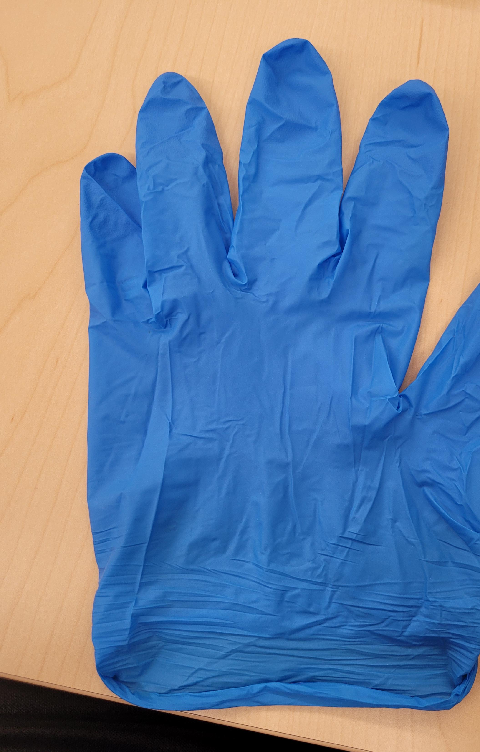
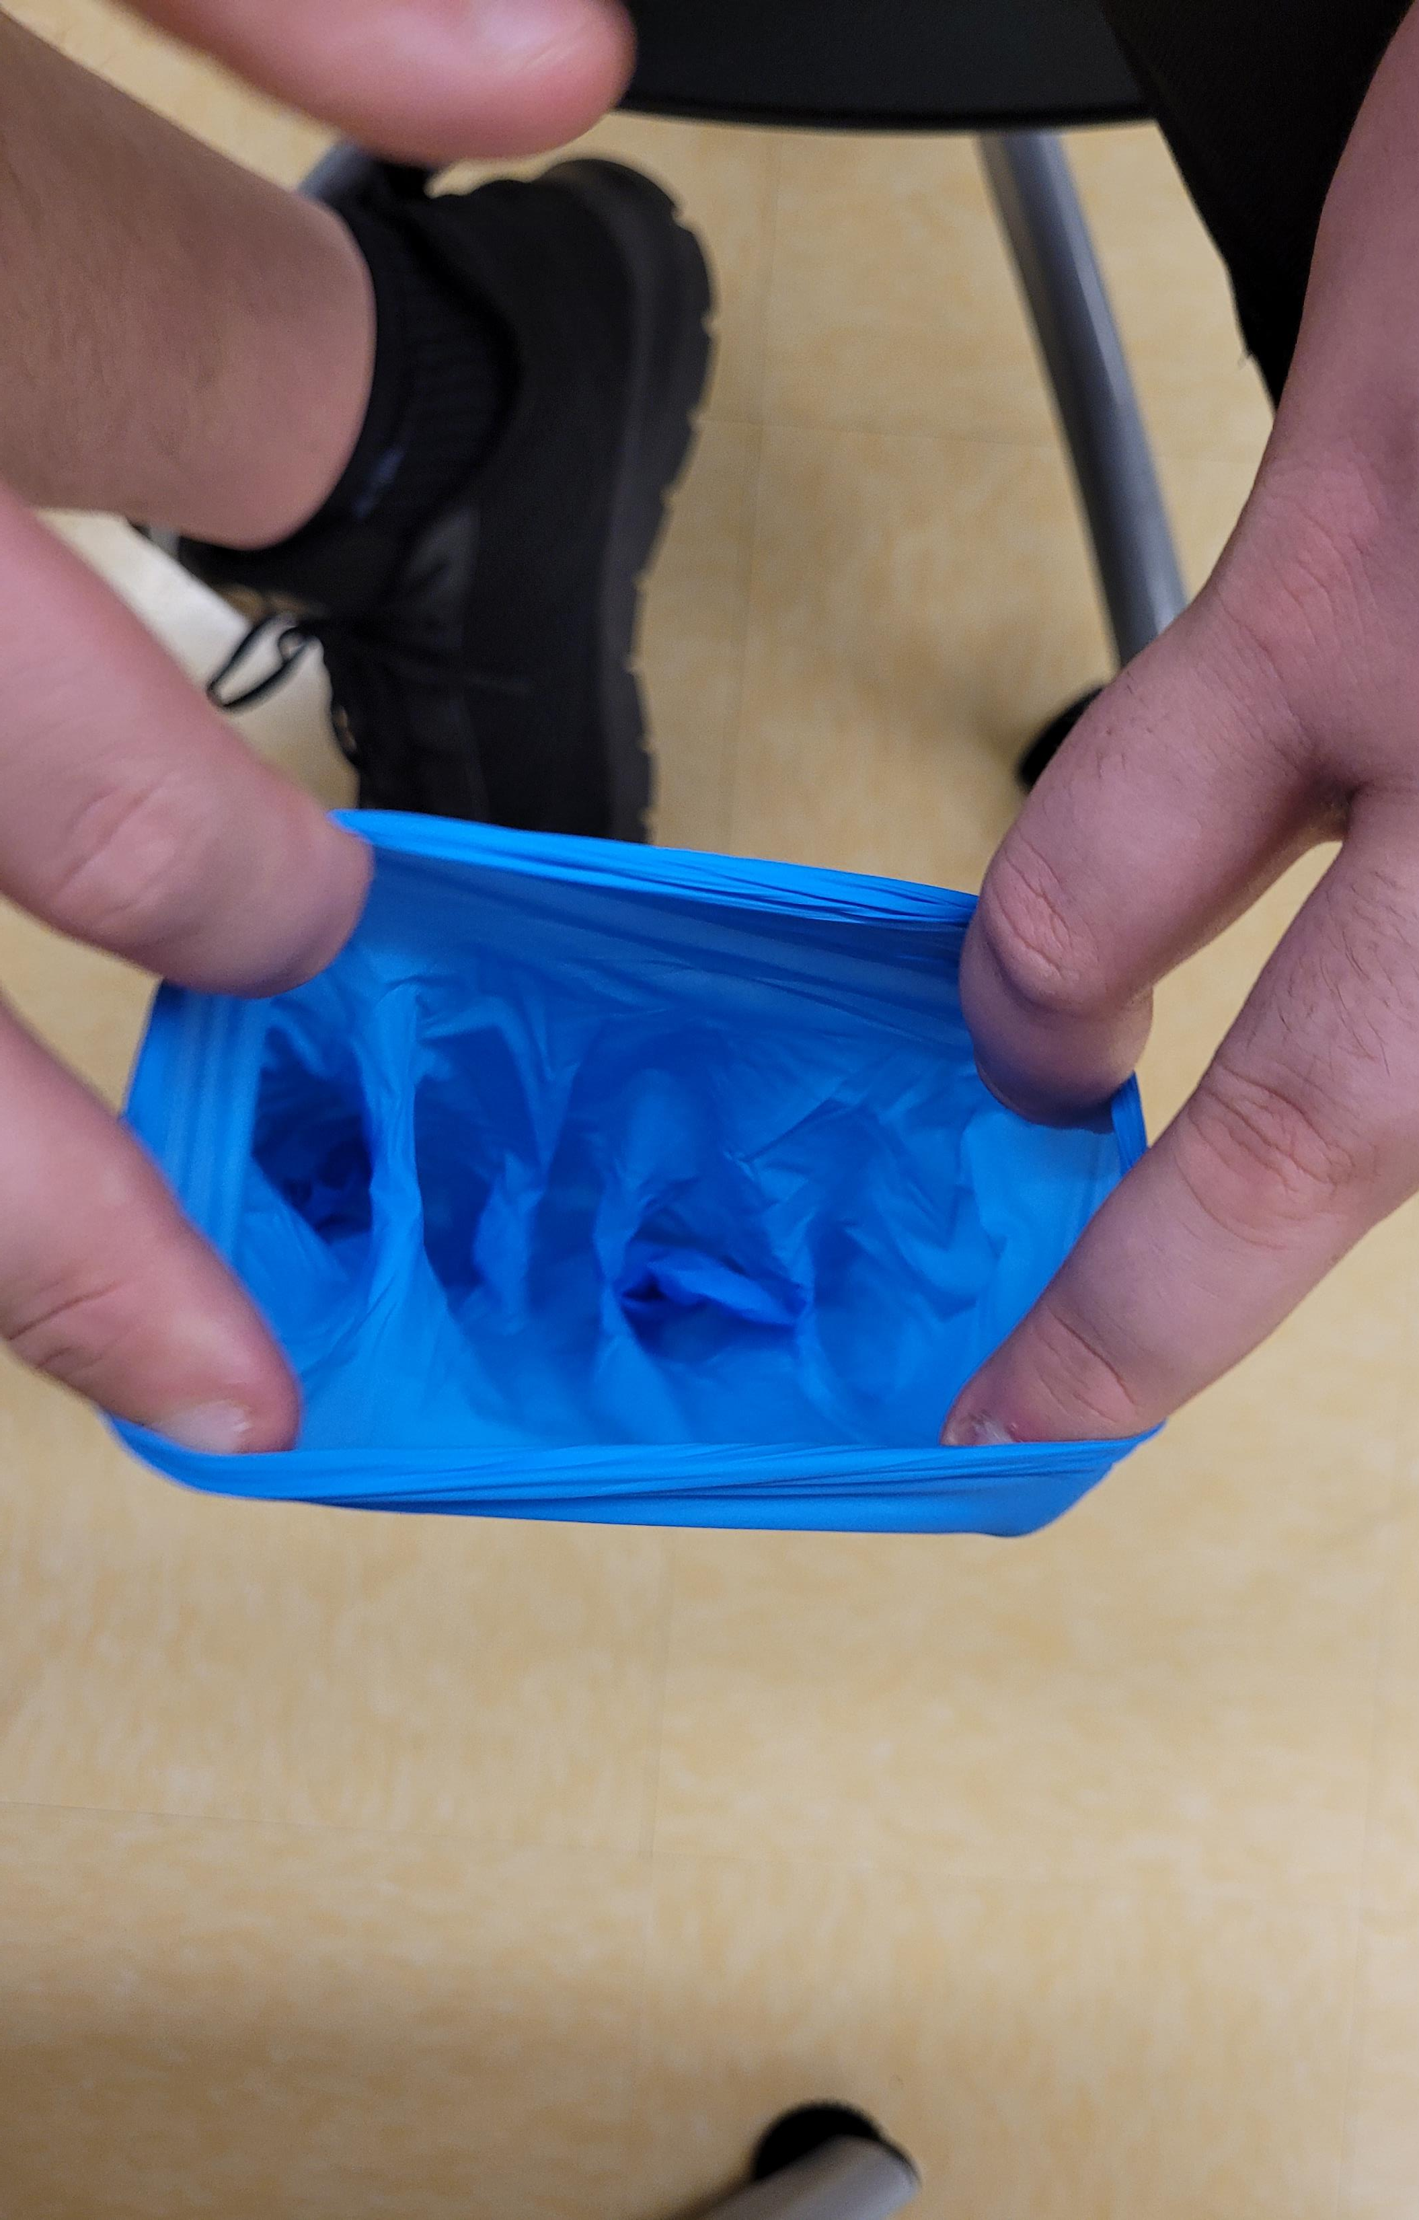
Inspiration of design
Open glove with 4 fingers
Vacuum under glove will expand it

Slide 3
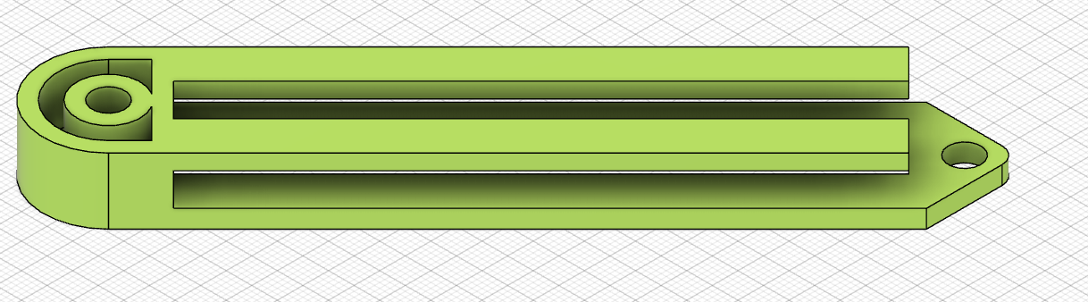
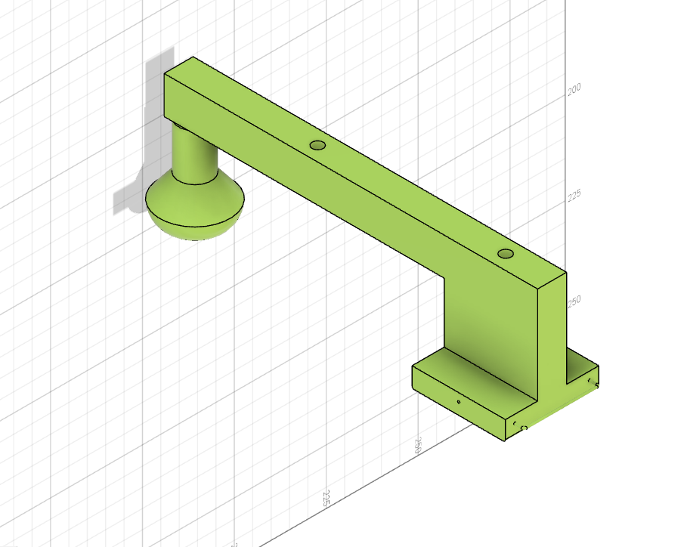
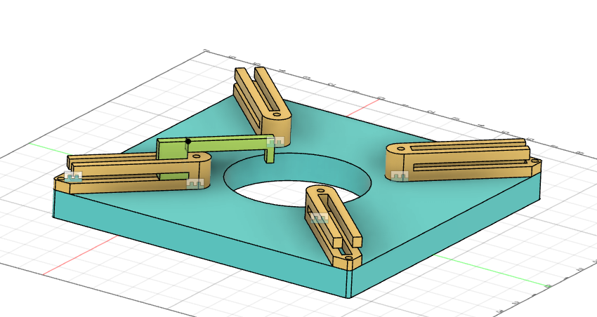
Design Concept
Rail
vacuum chamber under base plate hole
Trolley
Trolley will slide upon rail

Slide 4
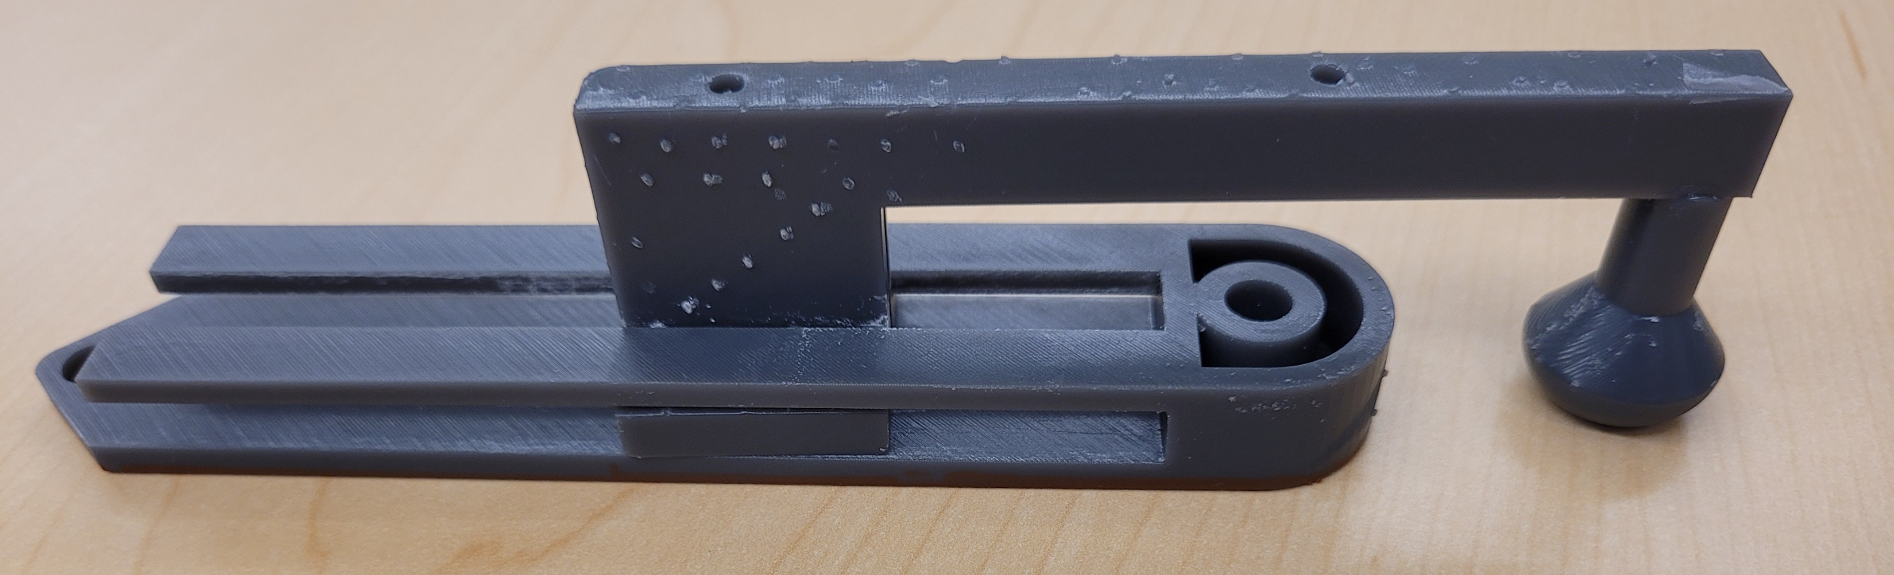
Results of Print
Plastic on plastic friction when sliding is low - medium.
Trolley doesn’t have as big of range as we might want
Trolley doesn’t slide into rail without flexing plastic of rail
Hook of trolley holds glove when stretched

Slide 5
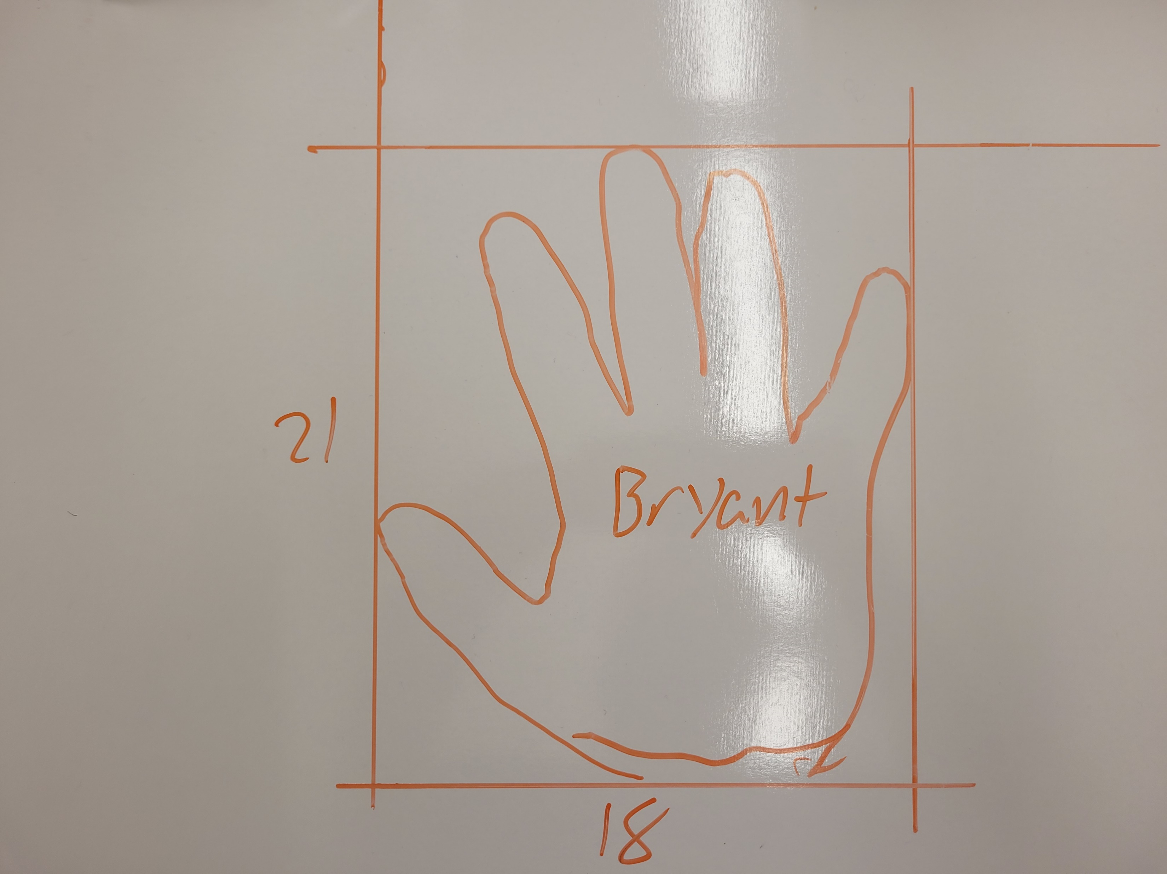
How big does the hole need to be?
Furthest that the glove will stretch ? ≈ 60cm circumference.
How will the hand enter hole?
18 cm will get a flat hand through hole.
18cm wide
? Cm tall

Slide 6
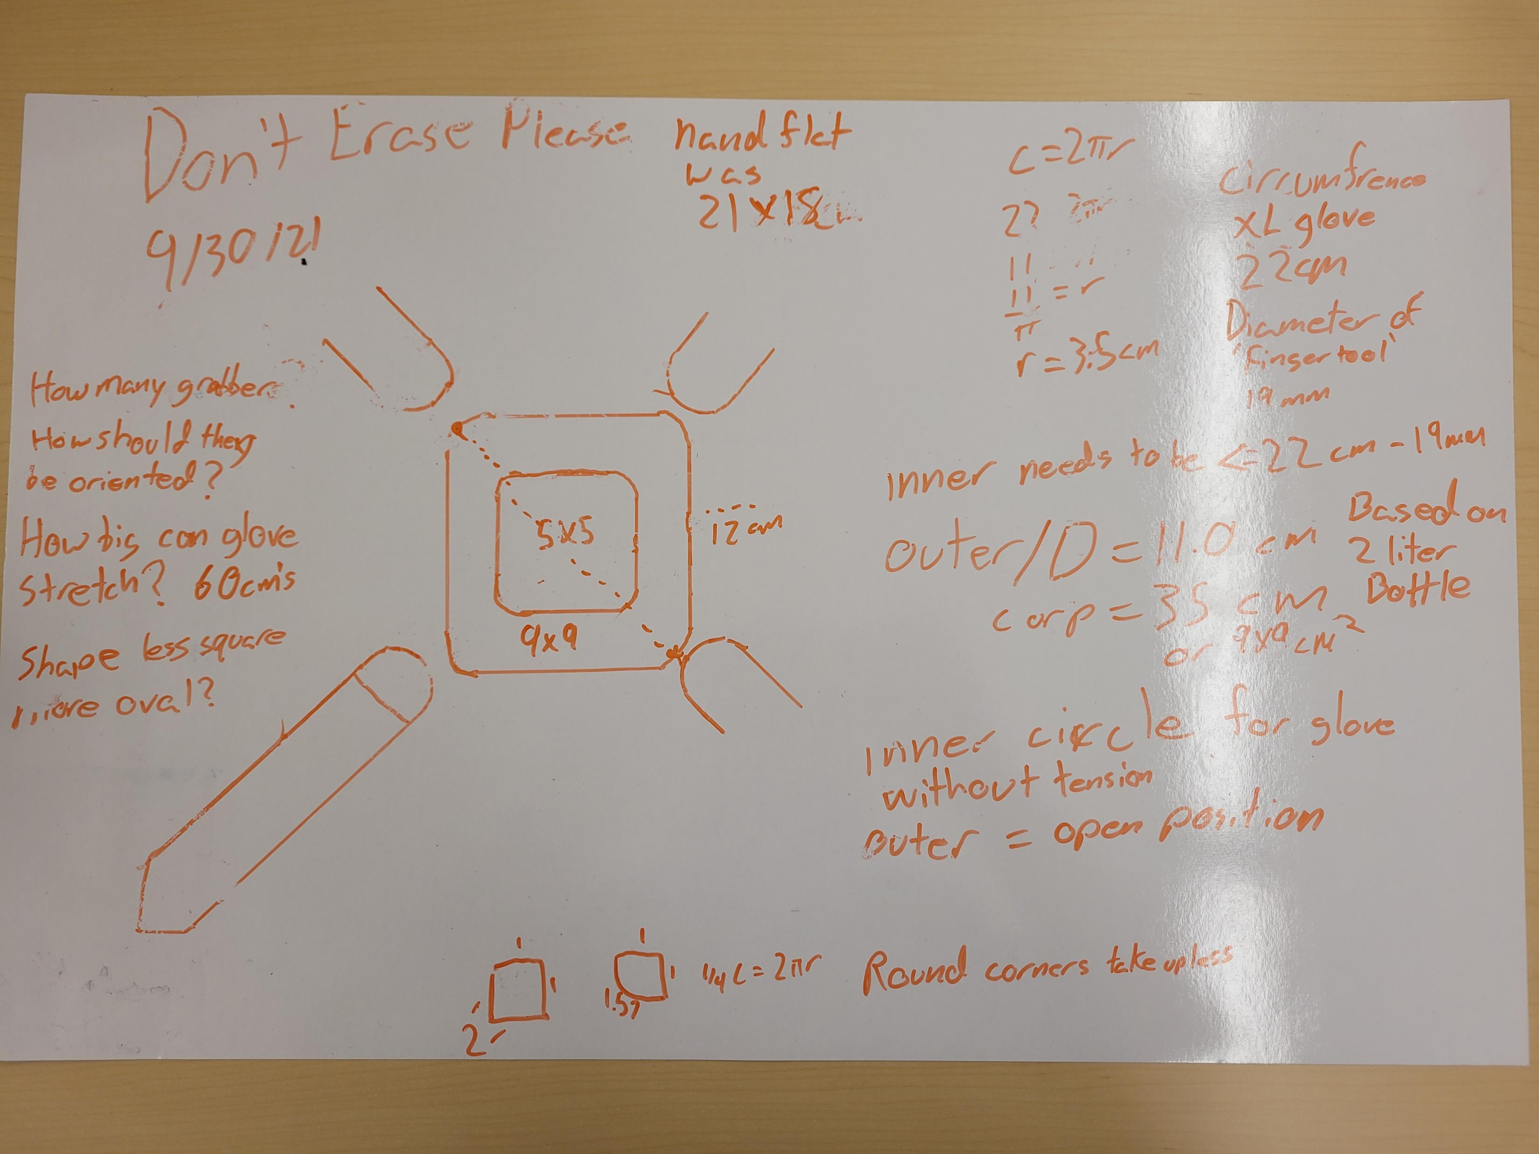
Measurements

Slide 7
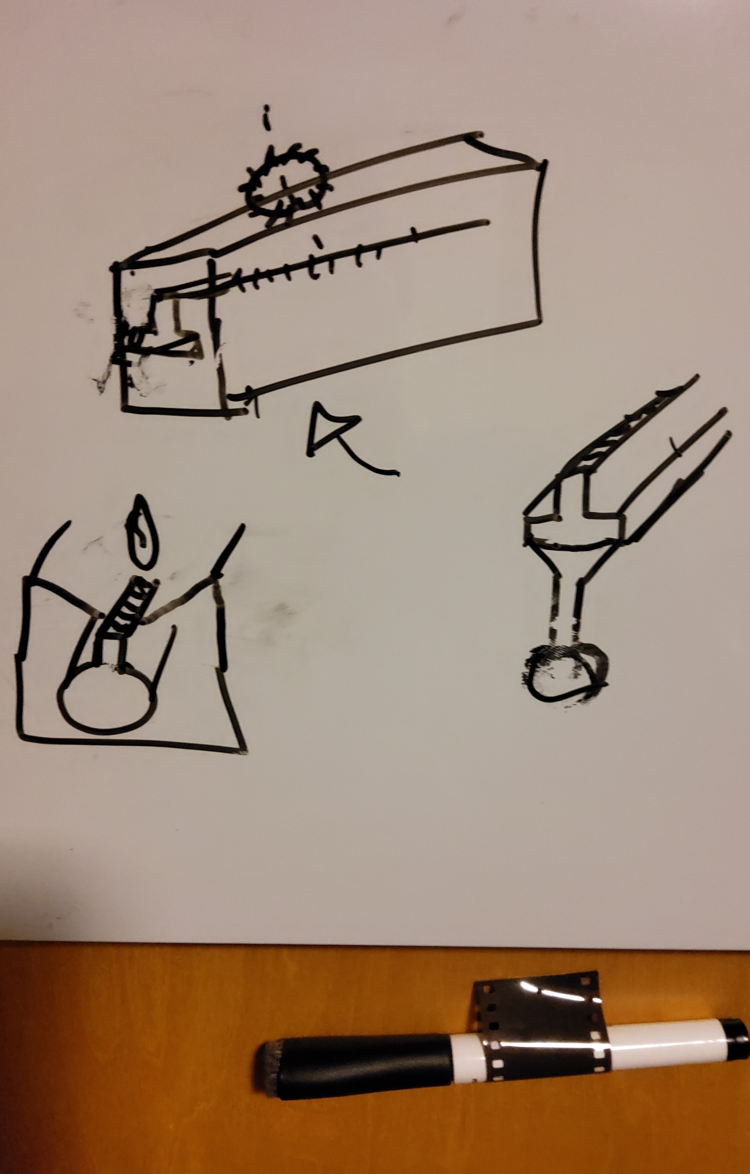
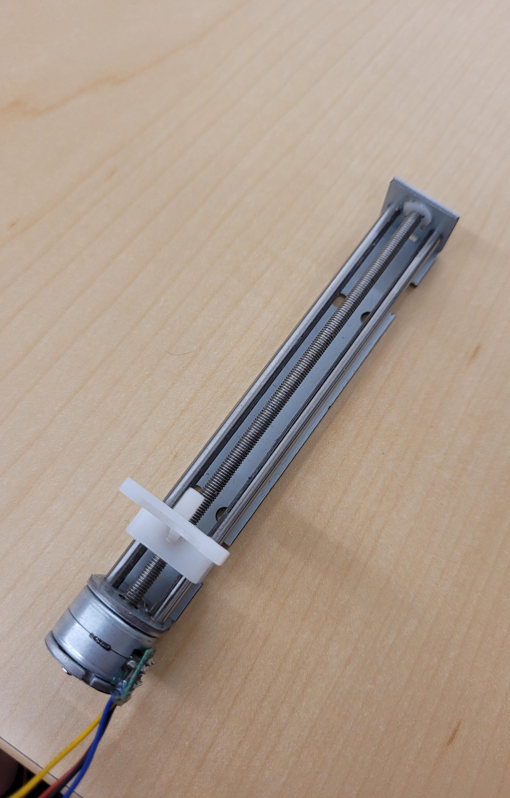
How do we move trolley?
Linear Actuator?
Rack and pinion?
String spool/pulley?

Slide 8
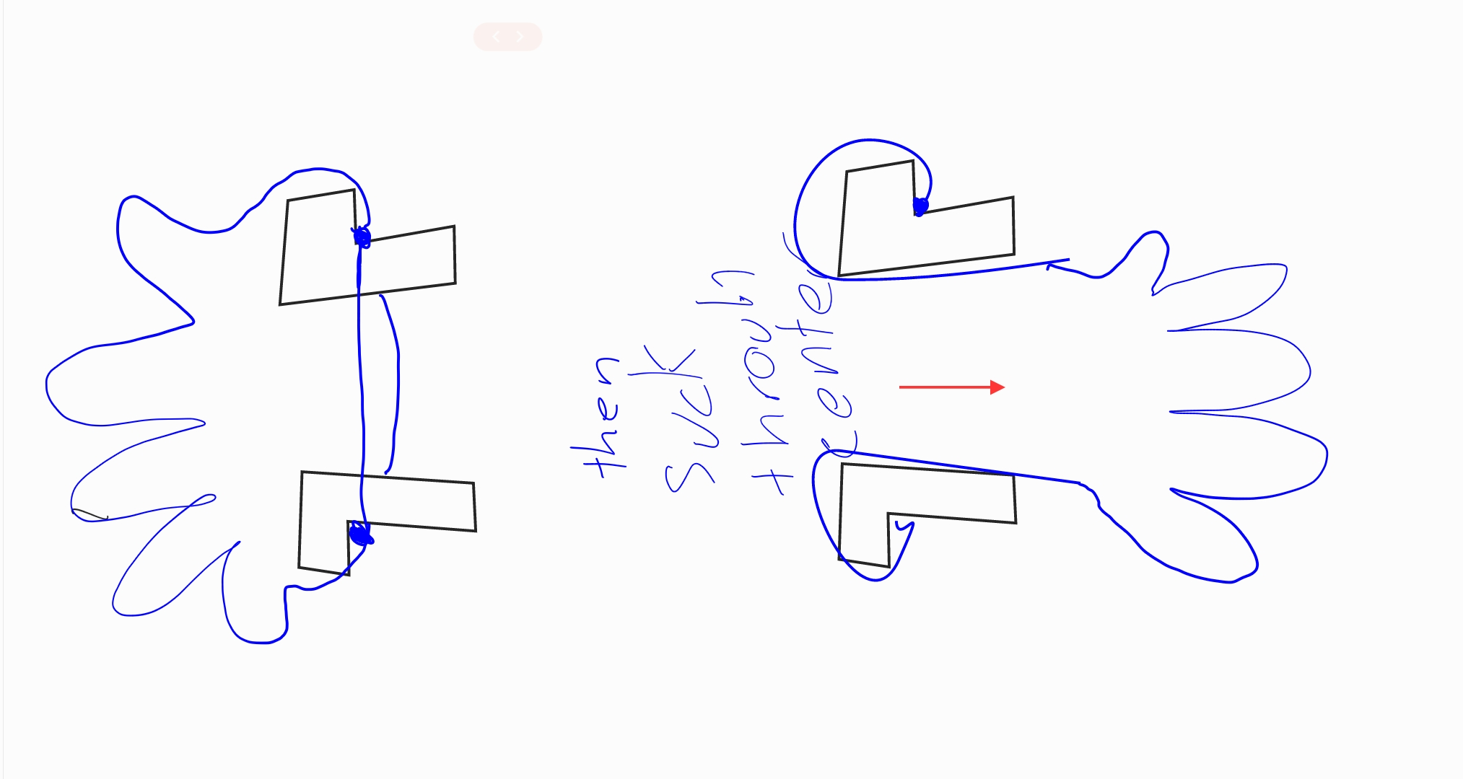
Orientation of Trolley fingers
Is one better than the other?

Slide 9
Questions for Team
What is the best way to give linear action to trolleys?
What is the optimum shape and size of the stretched glove?
How many trolleys should we have? Current design has 4.
Trolley
?cm wide
? Cm tall

